Slide 1
DEATH&amp; FERTILITY RATE
File created on: 10-05-2020 19:29:59

Slide 2
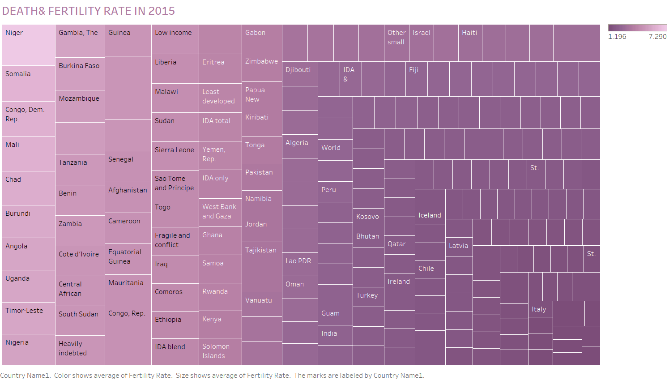

Slide 3
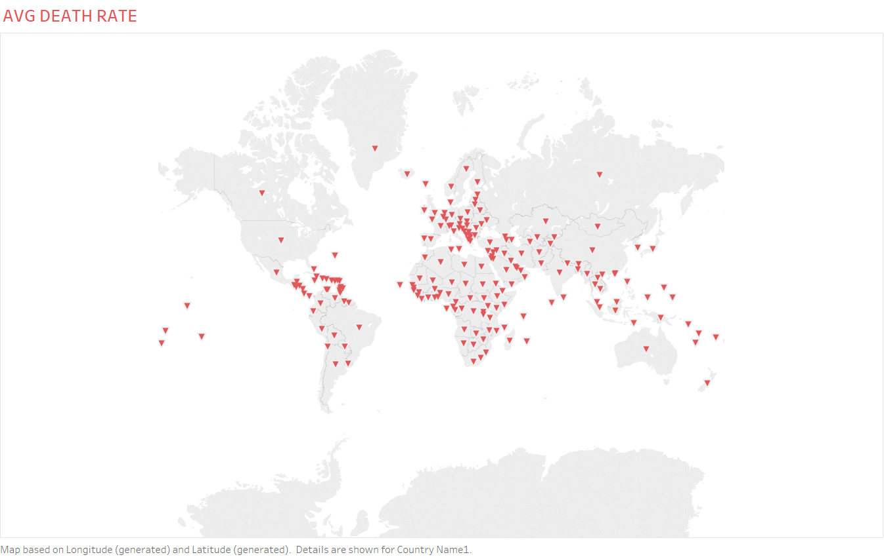

Slide 4
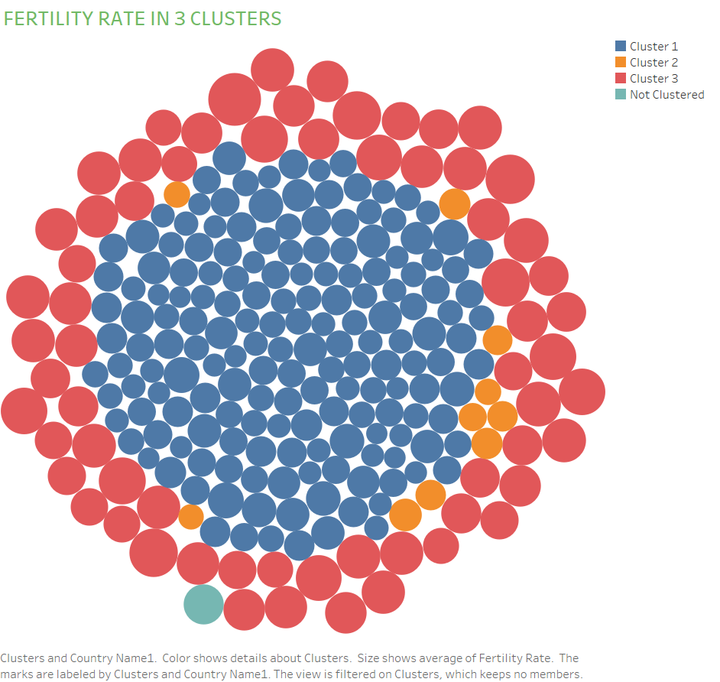

Slide 5
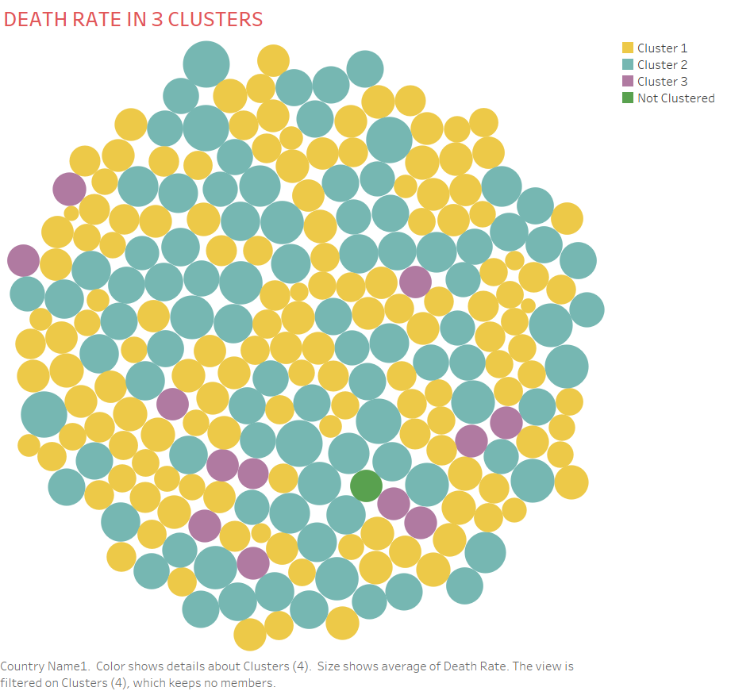

Slide 6
